Slide 1


Graphics and Computational Programming
Maria Tozo

Slide 2
Project Information
For this project I choose to do a parallel ray tracer. With an end result that is able to render some simple shapes with a choice of different material for each shape that would interact with multiple lights.
Throughout this video I will go over and discuss my research into ray tracing and parallelisation and how it helped me in design and implement my ray tracer

Slide 3


Theory and Design

Slide 4

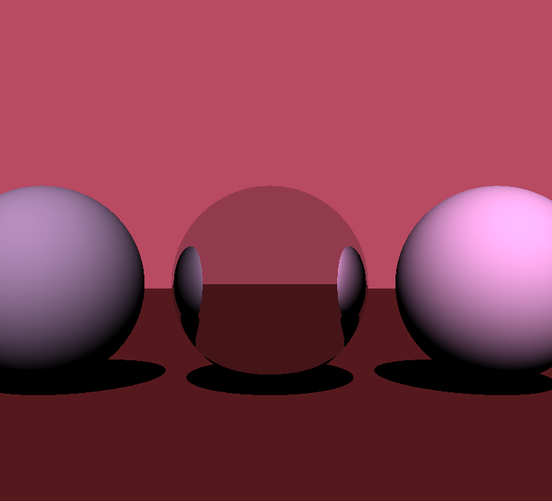
What is Ray Tracing
Ray Tracing is the process of rendering a 3D images on a 2D display by tracing a path of light through pixels on an image plane. Though ray tracing is capable of producing a much higher degree of realism over other rendering methods, it comes a much greater computational cost. This cost was fine for producing images in TV and film had been much to high for games to implement into real-time. But with technological advances, like the Nvidia GeForce RTX 2080, it is slowly becoming possible for real-time.

Slide 5
What is parallel programming
parallel programming is a type of computation in which many processes or the execution of processes are carried out simultaneously

Slide 6
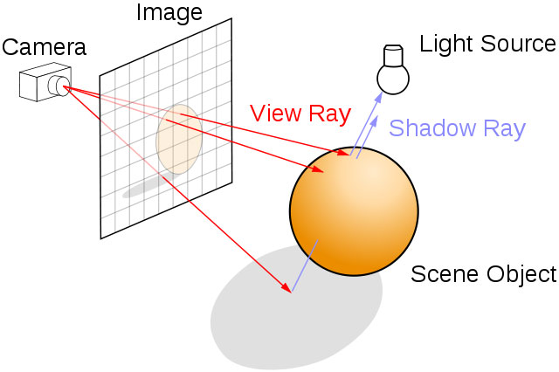
Ray Tracing – Rays and Camera
Now the bases of any ray tracer is the rays and the camera.
A ray is represented by 2 vectors, an origin vector and a direction vector. The "viewing" rays are used to represent each pixel in the screen and find what colour it is supposed to be. There are other rays used to check for shadows, lighting and reflections as well.
The camera is where these "viewing" rays are generated, here is where the 2D pixel coordinates are transformed into world space coordinates and a direction.
This Photo by Unknown Author is licensed under CC BY-SA

Slide 7
Ray Tracing – Intersections

Slide 8

Implementation

Slide 9
Evaluation

